Slide 1

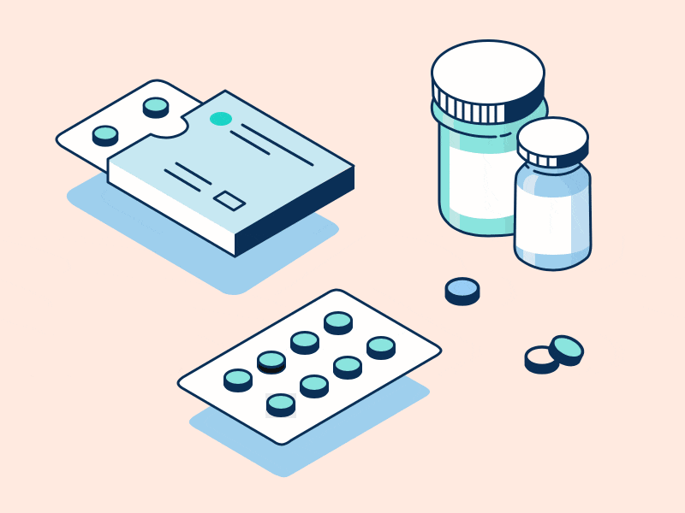
Project Development using Advanced Tools
Project Based Learning
Medicine Time Reminder

Slide 2

Team Members:
A42 – Amit Khadke
A70 – Pranav Salokhe
Guided By: Prof. Arun Desai

Slide 3

Problem Statement
Many people till today forget to take medicines on time which can affect their health.
So we are implementing a solution which will solve this problem and will notify them to take medicines on time.

Slide 4

Objectives
Remind users to take medicines
Customizable medicines schedule
Flexible reminder settings
User friendly

Slide 5

Implementation Plan
Analyze problems in real world
Define project scope
Design the system
Test the System
Deploy the proper System
Create project Plan

Slide 6
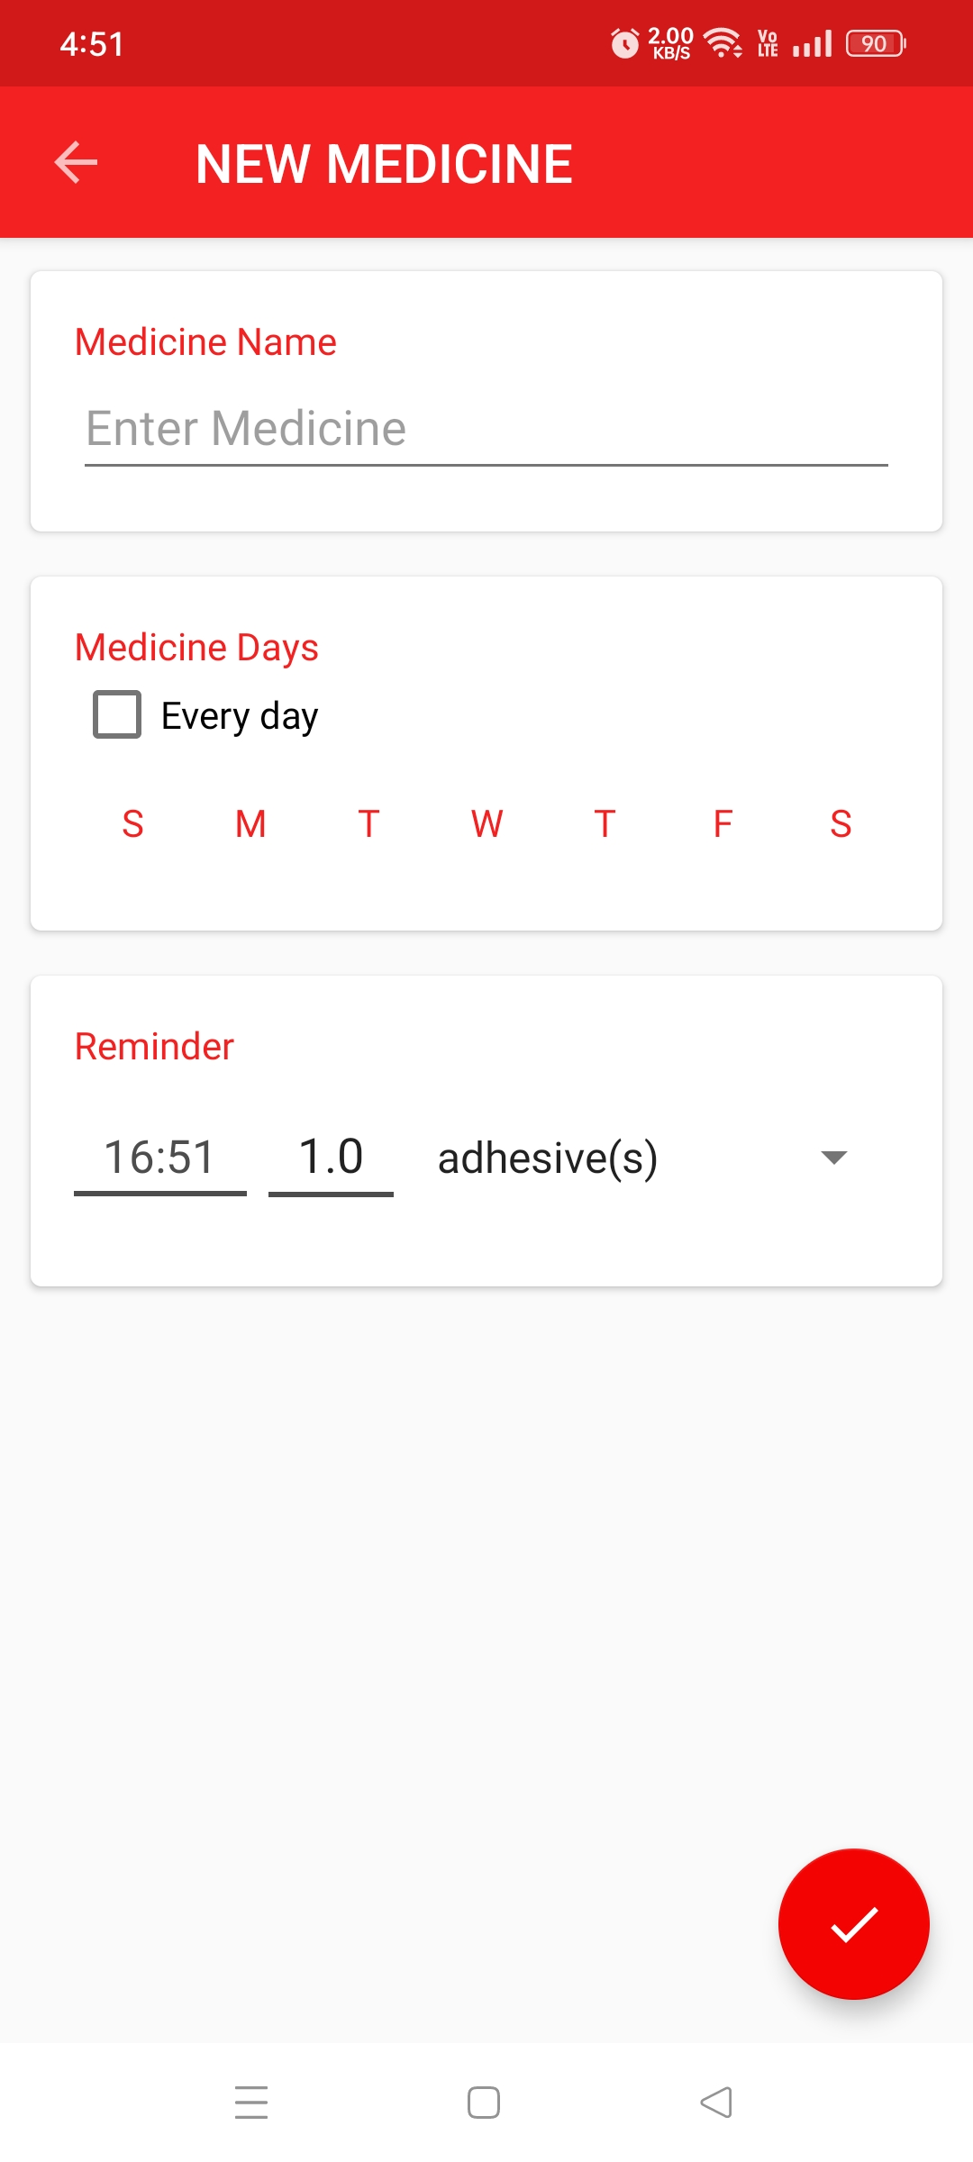
Screenshot for Add medicine
In this option users can easily add the medicine which they want to take. Here users can select on which days they want to take that medicine and on which specific time they want to take that dose. Users can also select how many doses they need to take, is it a capsule, a tablet or syrup etc.

Slide 7
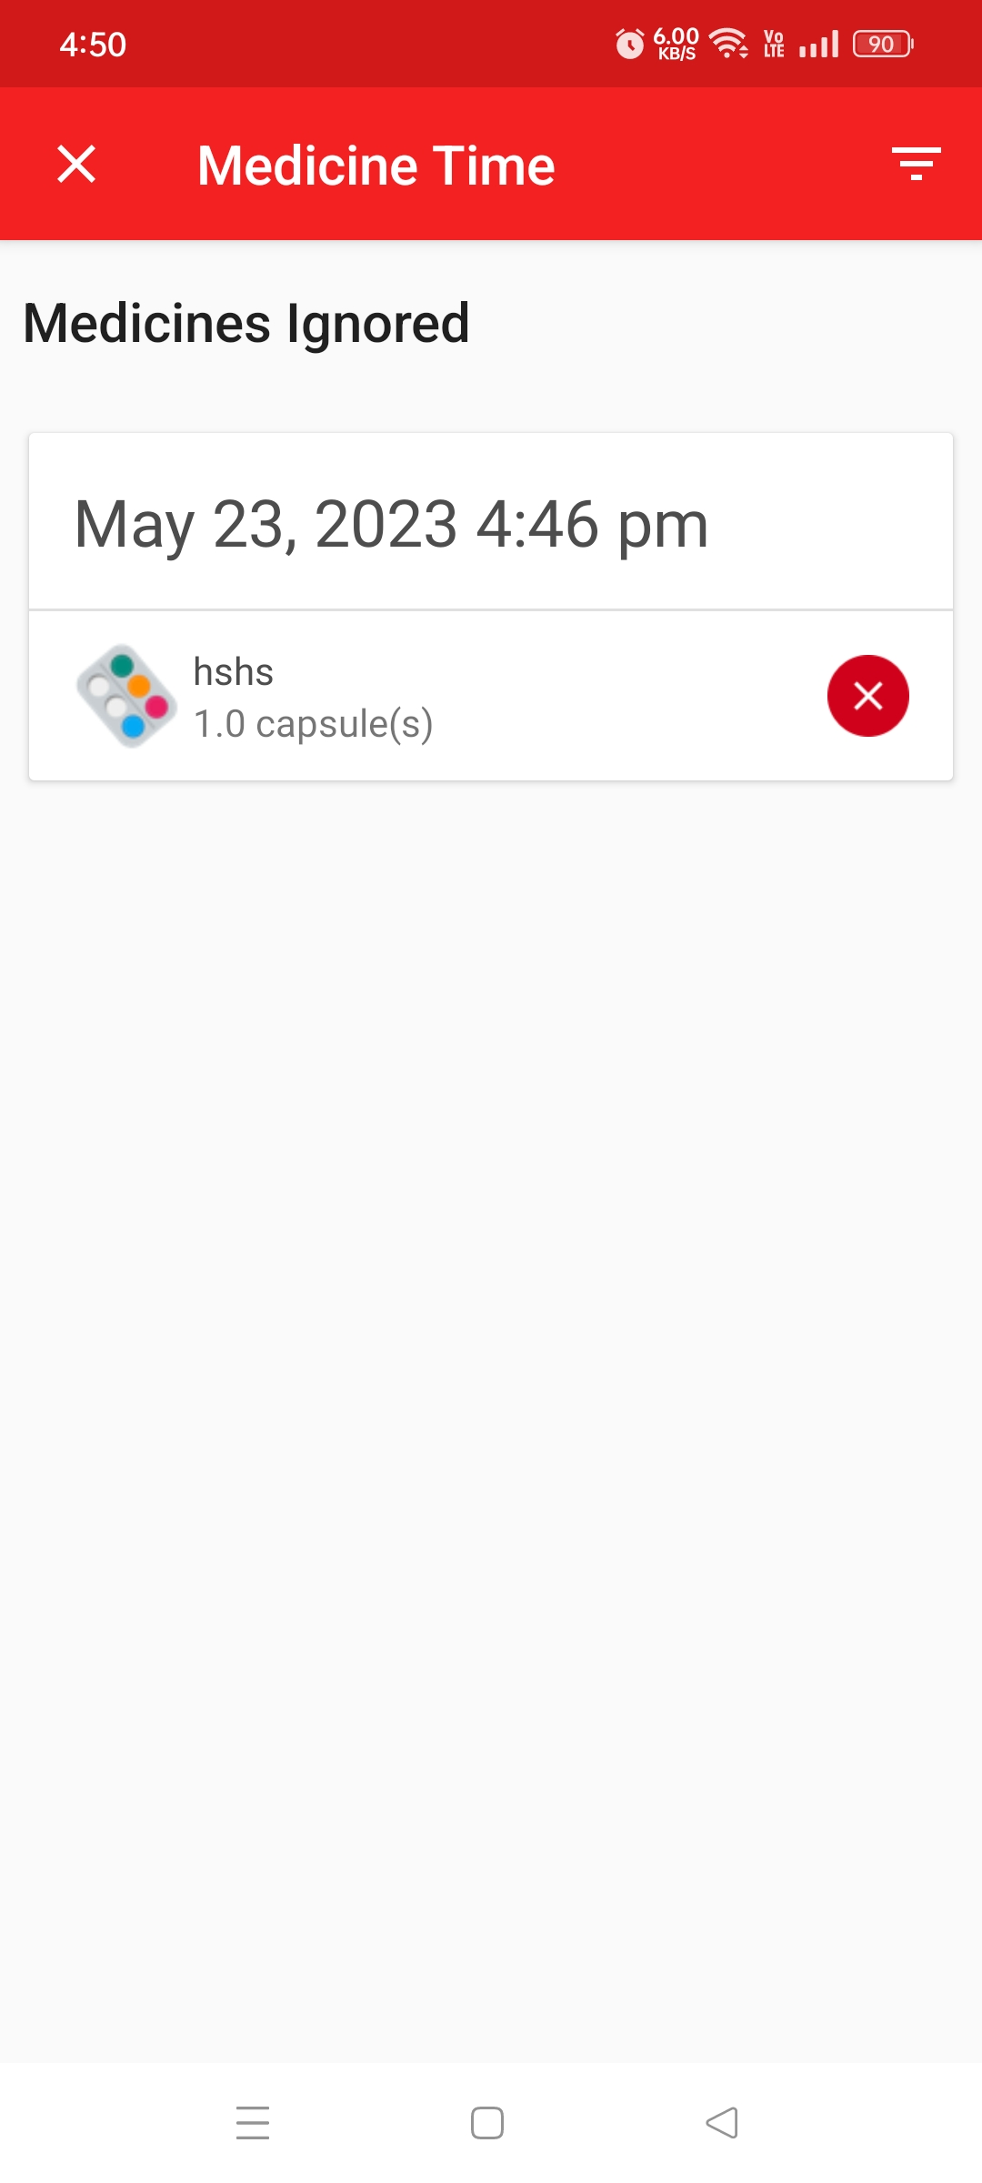
Screenshot of Ignored medicine
When the user adds a medicine and when he/she gets the reminder to take that medicine then he/she gets an option to ignore that specific dose. When the user ignores the dosage then it appears in the section of ‘Medicines ignored’.
When

Slide 8
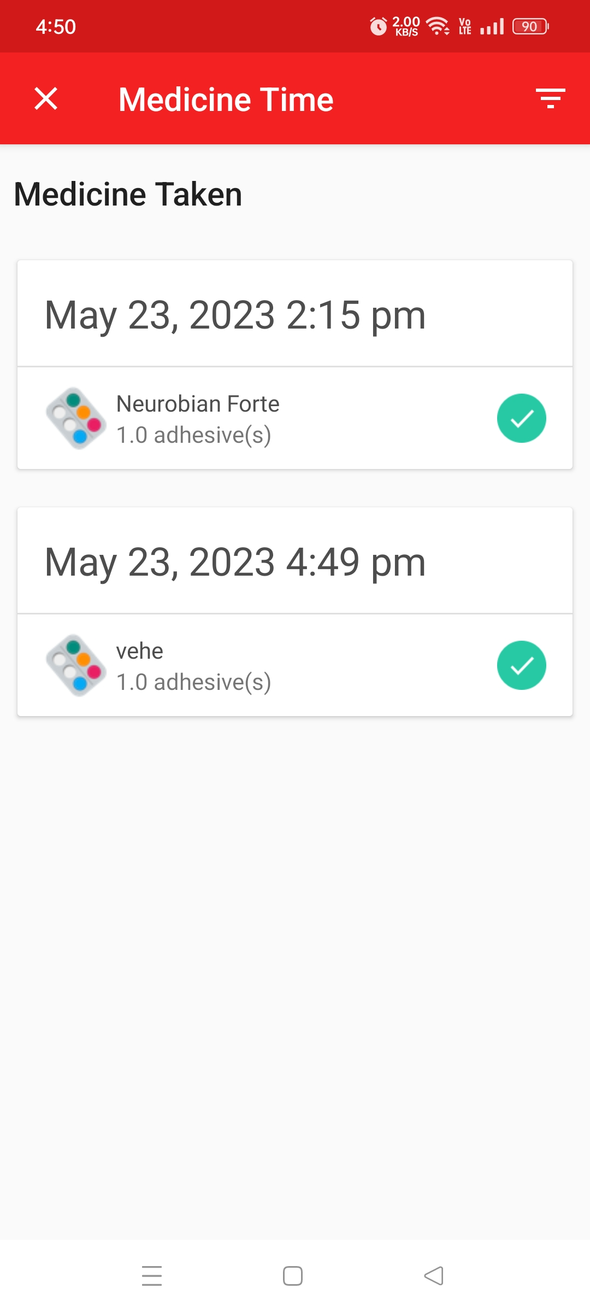
Screenshot of Taken medicine
Whenever the user gets a notification to take the medicines he/she can select the option to take medicine. When the user chooses this option then that medicine comes to the option of ‘Medicine taken’.

Slide 9
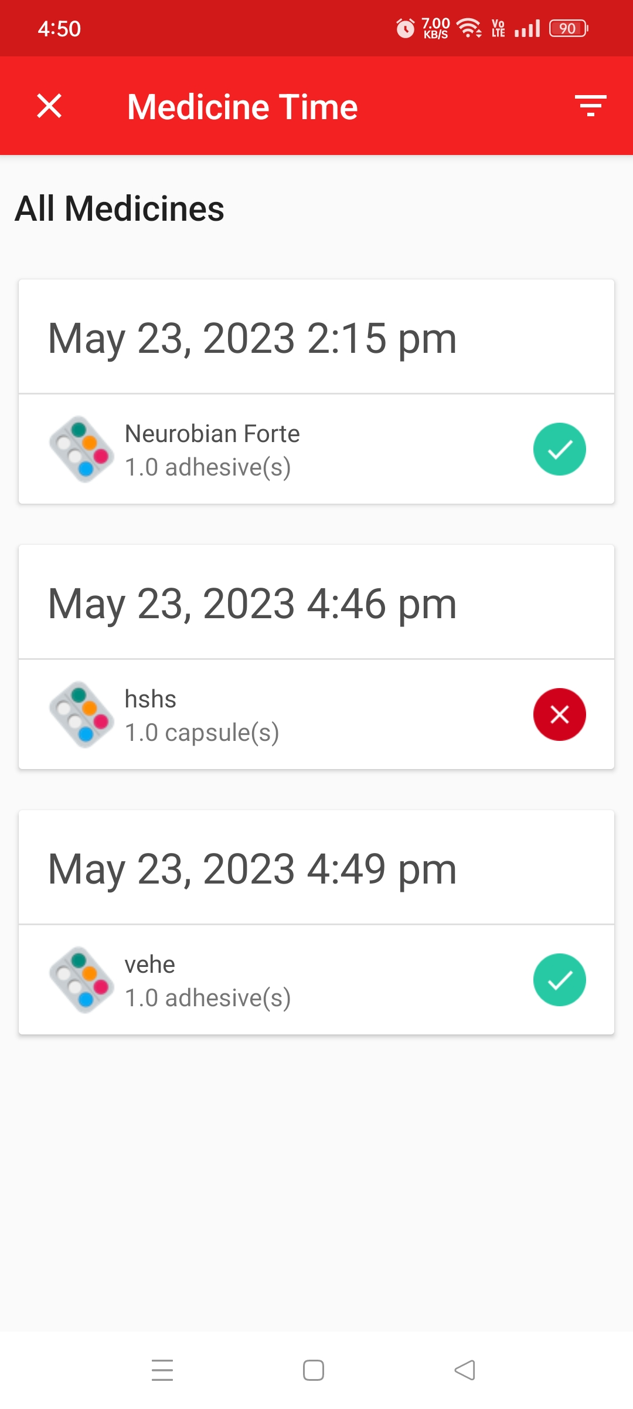
Screenshot of History of all medicine
When the user adds his/her medicines to get the reminder then, when the reminder rings he/she gets the option of either to take that dosage or to ignore that dosage. Whenever the user adds the medicines to get reminded these medicines get stored in this section and user can easily view which medicines he/she has taken and which medicines he/she has ignored in the section of ‘All medicines’.

Slide 10
Thank You !

